Slide 1
INTELLIGENT WALKING SHOES FOR BLIND AND DEAF PERSON
Presented By:
Rajawant Yadav
Ranjit Kumar Chauhan
Sudhir Kharawar
Guided By:
Dr. Aditya Khamparia
Head of Department
Computer Science
BBAU Satellite Centre Amethi

Slide 2
Introduction
There is approximately 39 million people in the world are blind in 2007 according to World Health Organization.
India is now home to the world’s largest number of blind people. Of the 39 million people across the globe who are blind, over 15 million are from India.
In our India not so much advance technologies and equipments use for blind people and very less number of products launched in India.

Slide 3
Abstract
Presently, blind people use a white stick as a tool for directing them when they move or walk.
Here, we will develop shoes which can serve as a blind stick being more efficient and helpful than the conventional one.
Our project advanced shoes mainly based on the ultrasonic sensor which is sense the object near the shoes and alert the blind person.

Slide 4
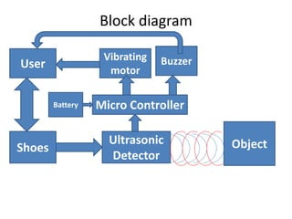

Slide 5
Components
Ultrasonic sensors
Microcontroller
Buzzer
Vibrating motor
Battery
Shoes
Switch
Jumper Wire
Arduino nano

Slide 6
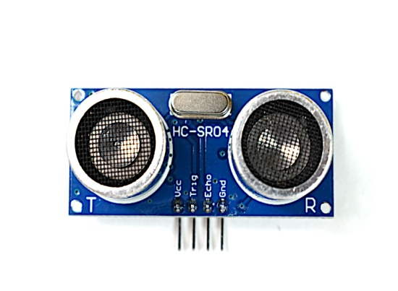
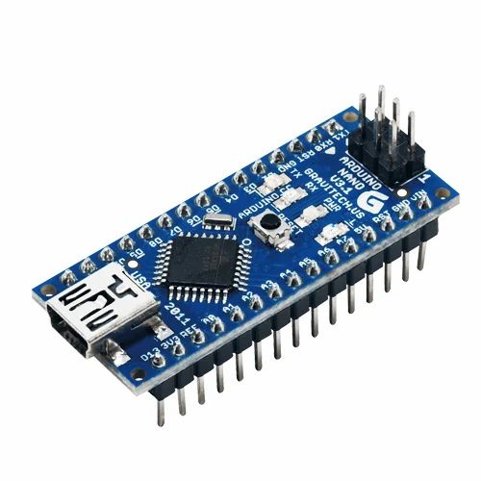
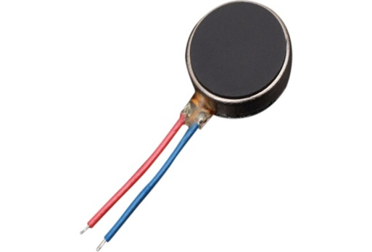
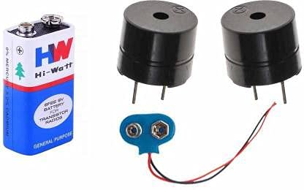
Ultrasonic sensor
Arduino nano
Vibrating motor
Battery and Buzzer

Slide 7
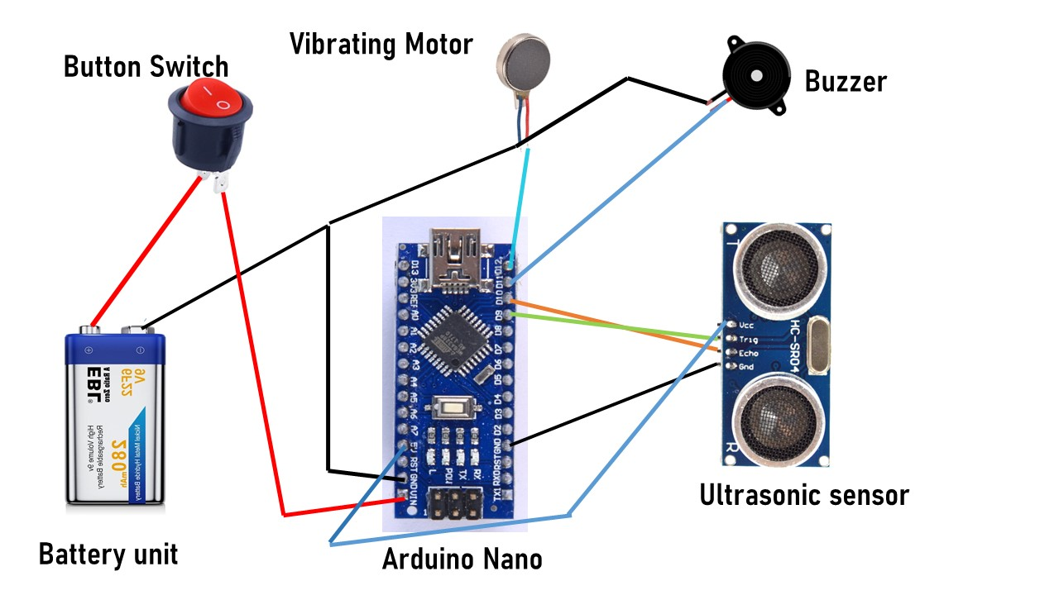
CONNECTIONS

Slide 8
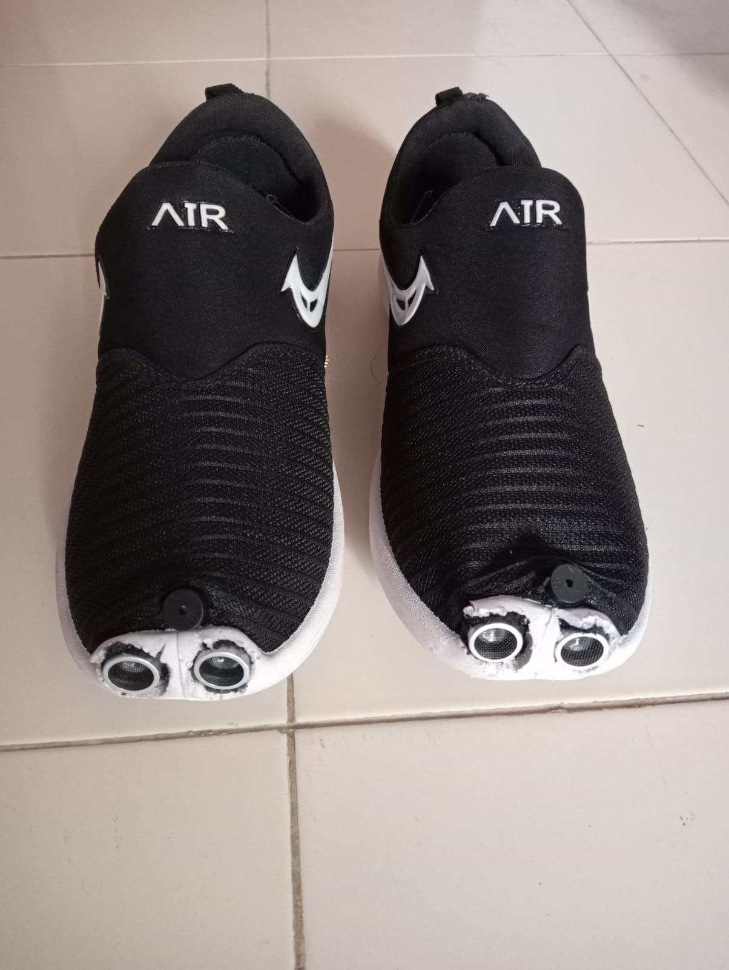
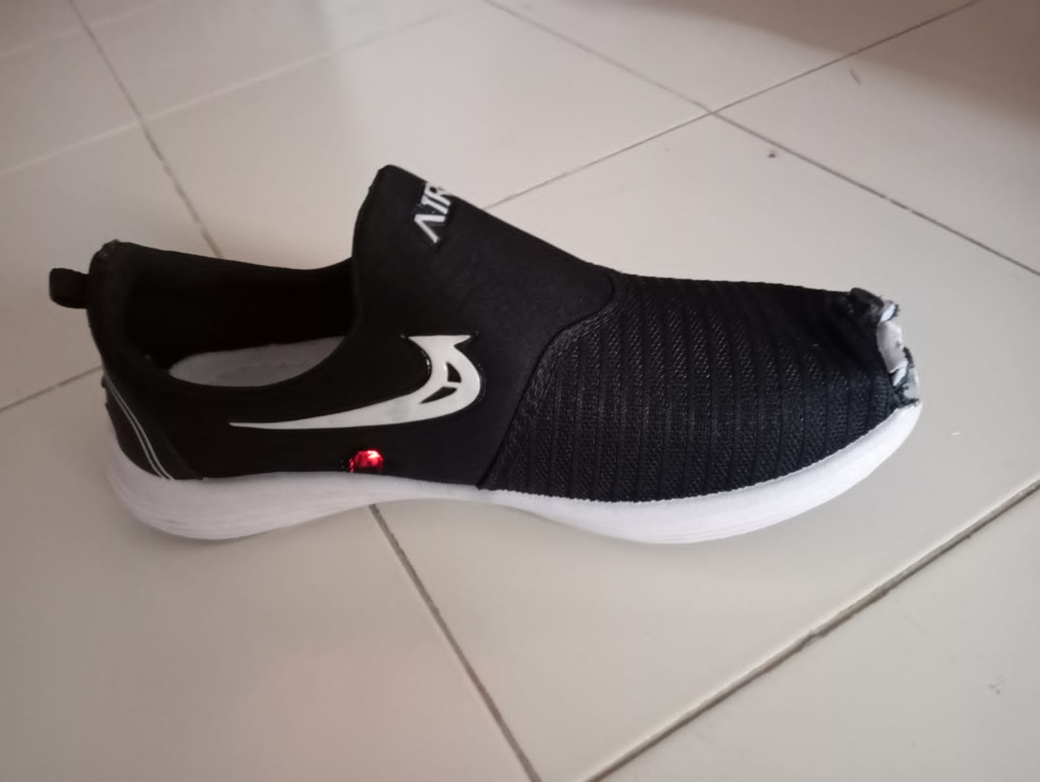
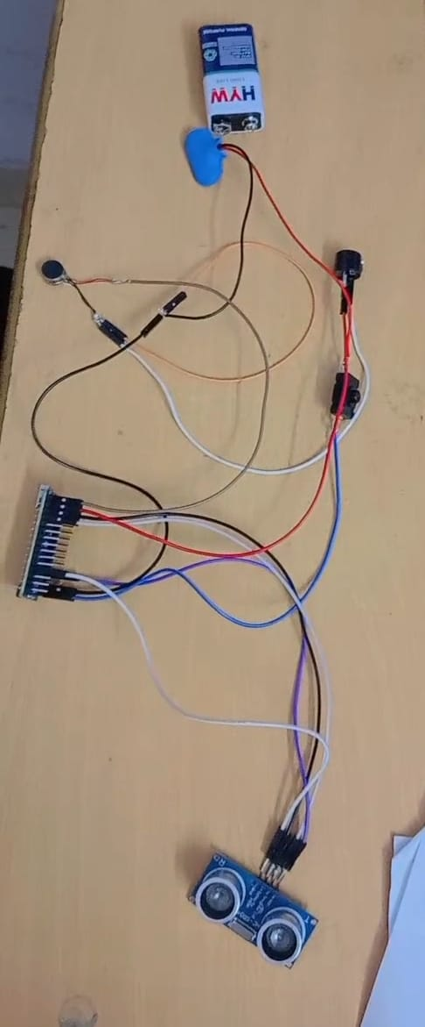
SNAPSHOTS

Slide 9

THANK YOU

